Slide 1
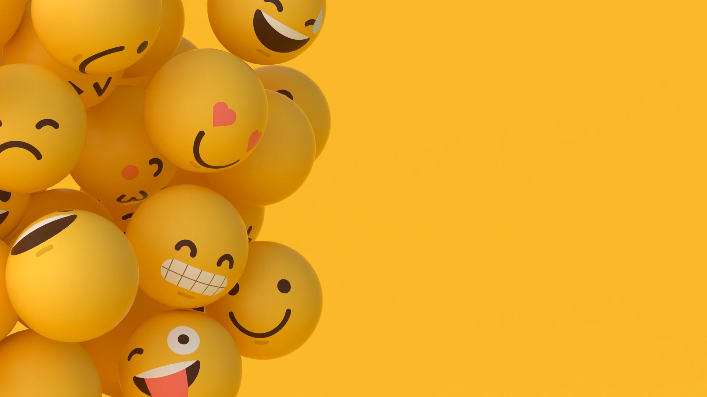
Stylistic emoji generation with a generative adversarial network
Team Members:
Xiaotong Sun, Ian Moncur, William Shattuck
Notes:
Is “Stylistic emoji generation with generative adversarial network” as the title better?

Slide 2
Problem Statement
Using Gan generate stylistic emojis
Emoji is very popular in social media apps, this project is trying to generate our own customized emojis by using GAN.

Slide 3
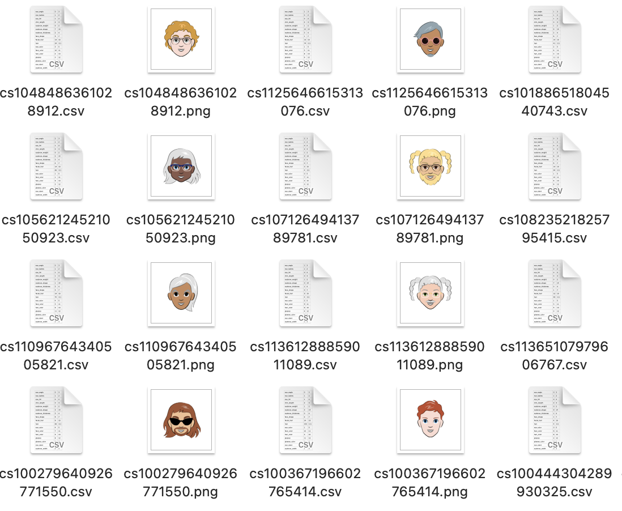
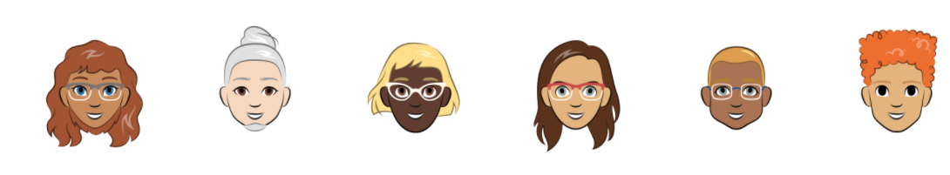
Dataset and Sources
Bitmoji dataset
With two disjoint sets of
10k and 100k random bitmoji cartoons.

Slide 4
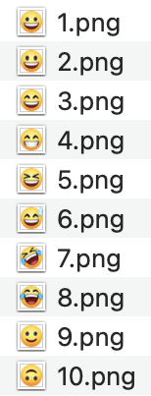
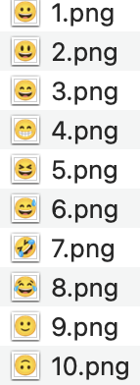
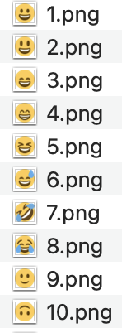
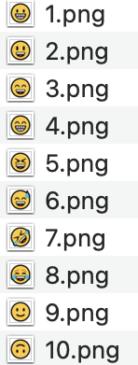
Dataset and Sources
Backup
datasets
Apple Facebook Twitter Windows
https://www.kaggle.com/datasets/subinium/emojiimagedataset?resource=download.

Slide 5
GAN
Generative
Generate fake images that look like real images. It learns the probability of features X. The generator takes noise (random features) as input noise.
discriminator
A binary classifier and tries to discriminate the real images and the images created by the generator. It learns the probability of class Y (real or fake) given features X. The probabilities are the feedback for the generator.
Generator learns to make fakes that look real.
Discriminator learns to distinguish real from fake.

Slide 6
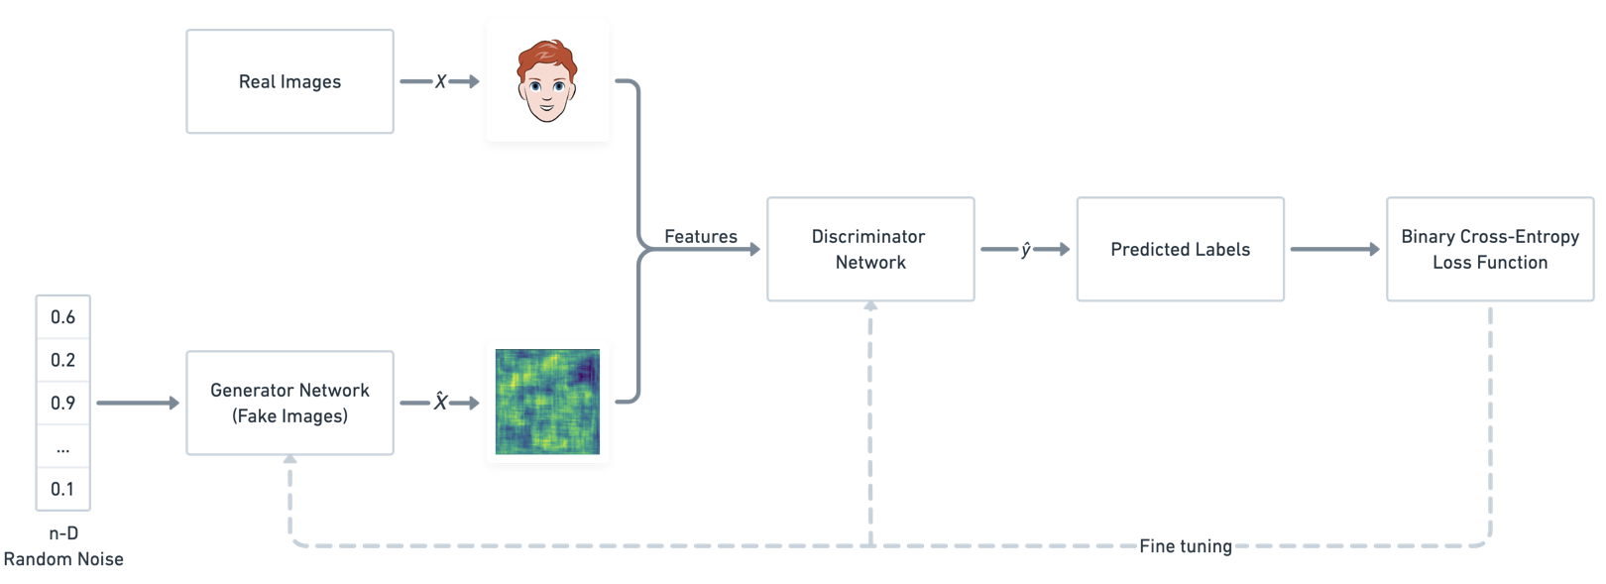
GAN model
Define Generator and Discriminator network architecture
Train the Generator model to generate the fake data that can fool Discriminator
Train the Discriminator model to distinguish real vs fake data
Continue the training for several epochs and save the Generator model

Slide 7
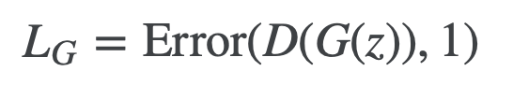
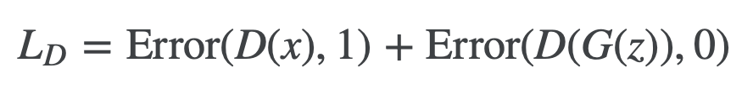
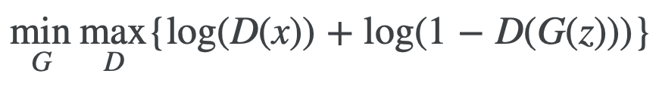
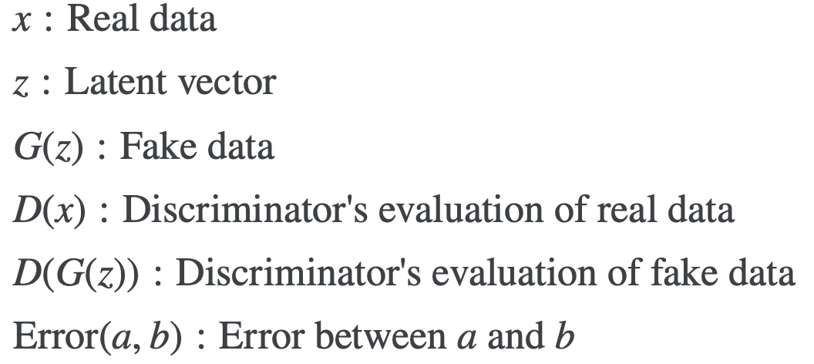
Mathematics behind GAN
Loss Function
Binary Cross-Entropy

Slide 8
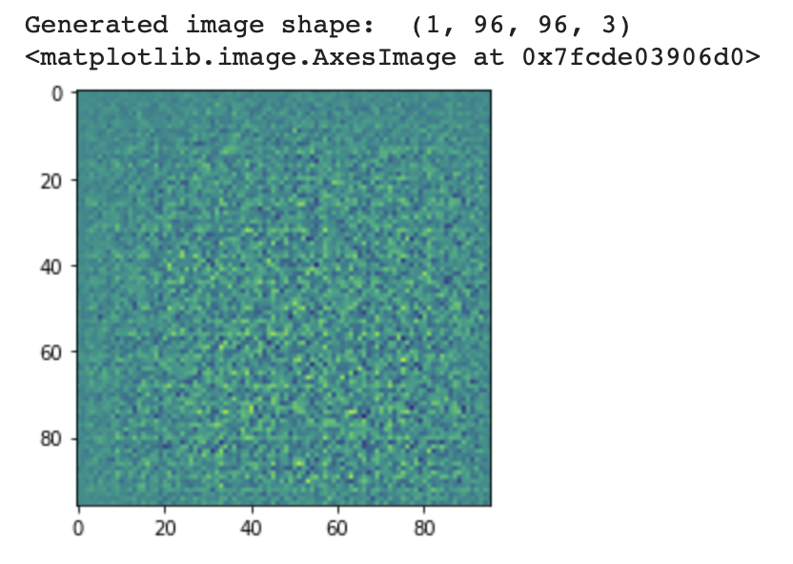
Present Work
The image created by
untrained Generator—noise.
Code logics:
Load data
Define the Models
Define the Loss and Optimizers.
Training Pipeline
Train the model
Generator
Discriminator
precompile and improves performance.

Slide 9
Image preprocessing
Load Dataset
Download the dataset online as a zip file, upload it to google Colab and unzip.
Give the dataset path.
Read the PNG file only.
Convert RGBA to RGB format.
Add time count functions.

Slide 10
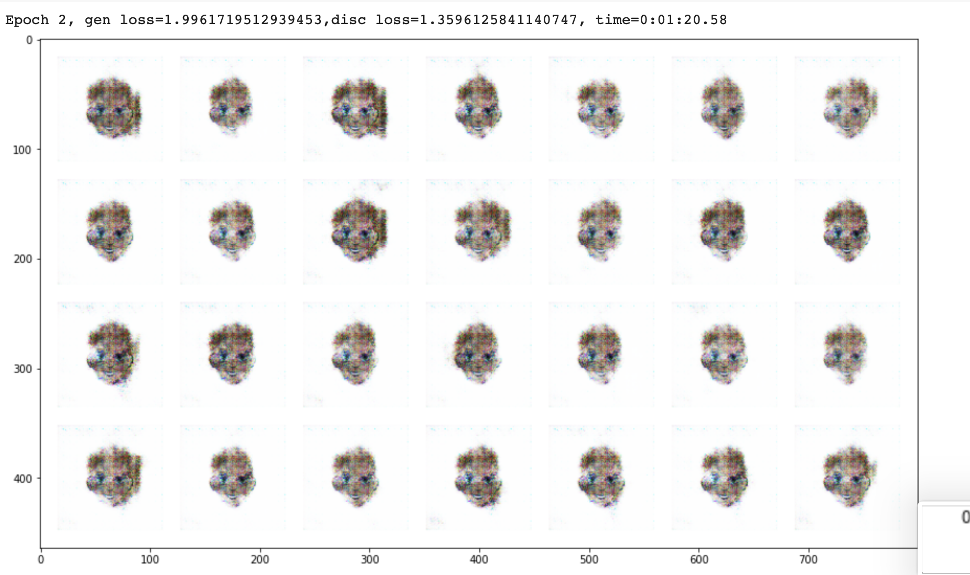
Present Work
Trained a demo GAN model with 10k bitmoji datasets.
EPOCH 2.

Slide 11
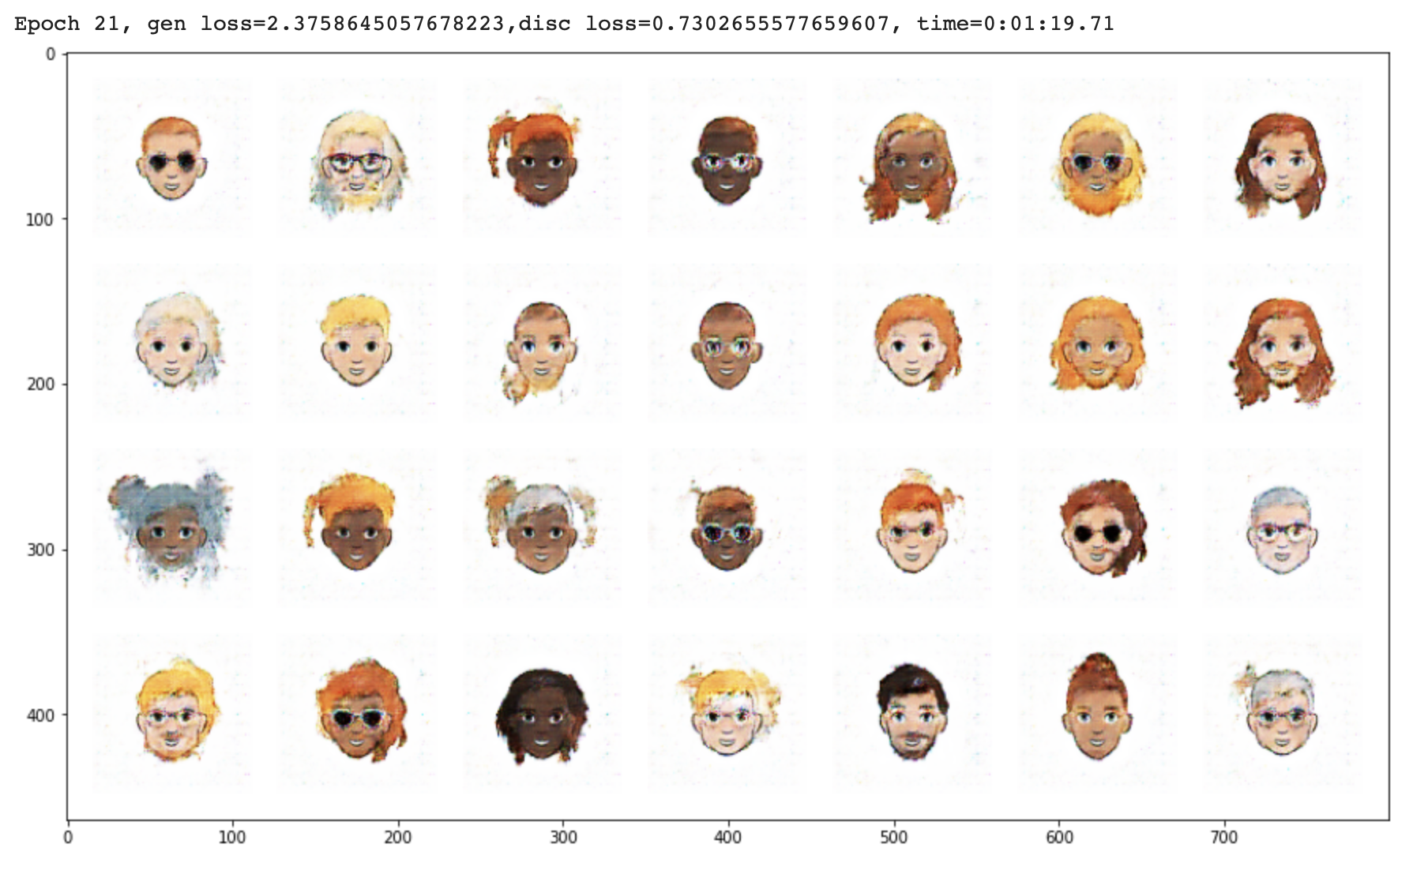
Present Work
Trained a demo GAN model with 10k bitmoji datasets.
EPOCH 21

Slide 12
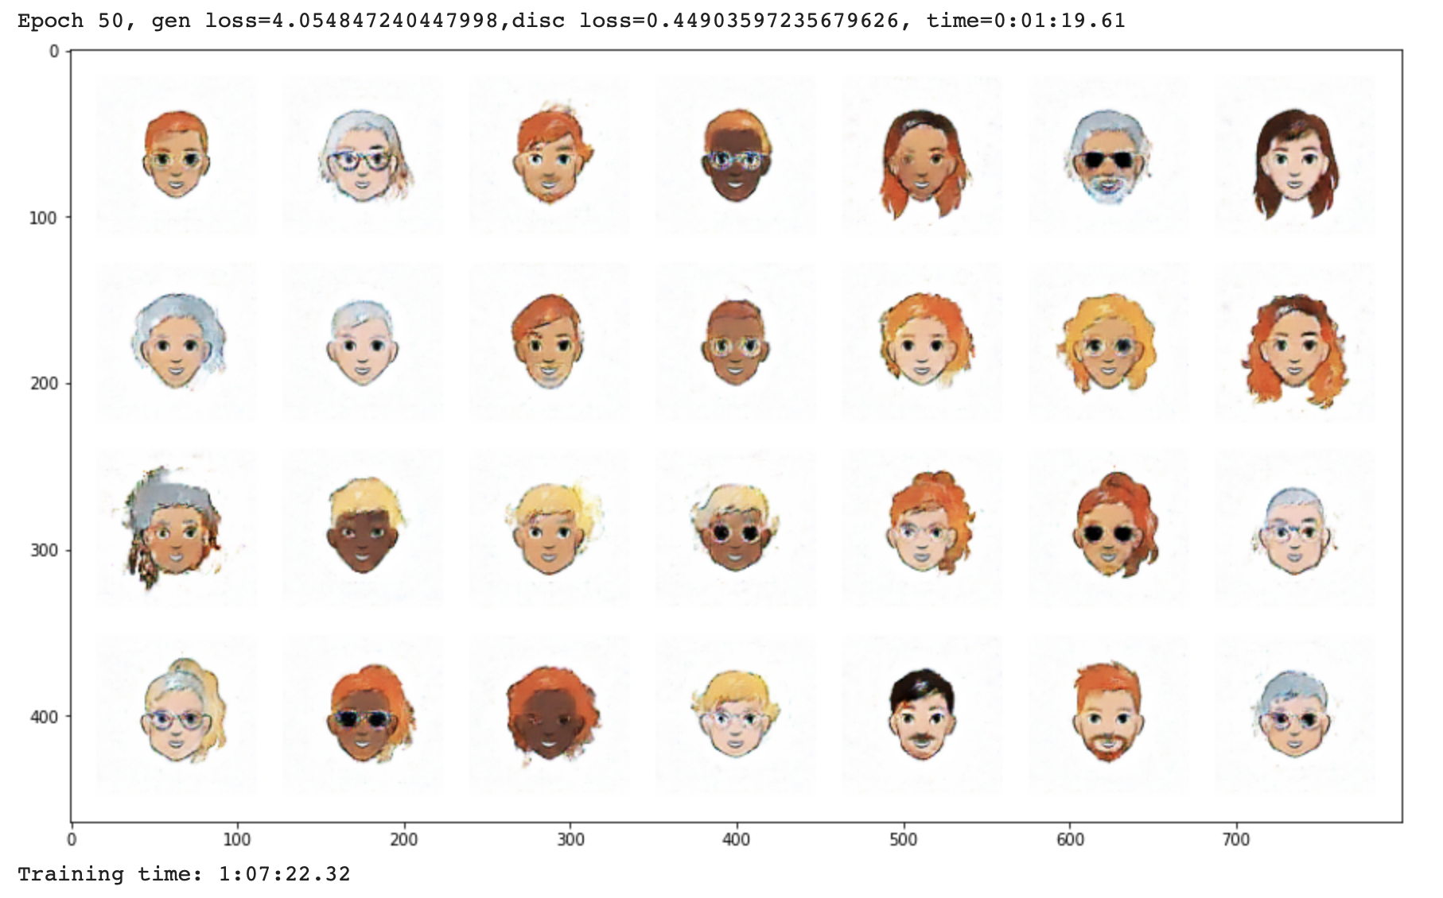
Present Work
Trained a demo GAN model with 10k bitmoji datasets.
EPOCH 50

Slide 13
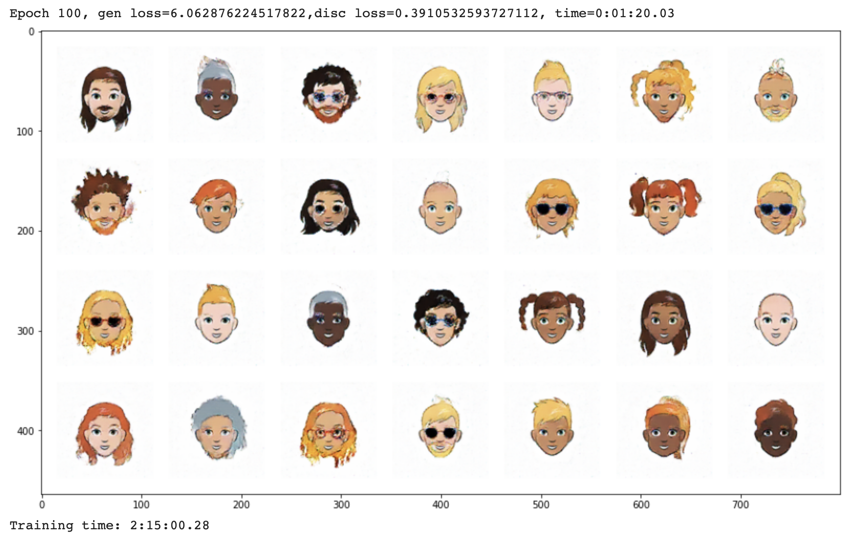
Present Work
Trained a demo GAN model with 10k bitmoji datasets.
EPOCH 100

Slide 14
Challenges
How to improve the GAN model?-Hyperparameter
Using combined datasets may have unexpected problems and graphs.

Slide 15
Future Work and Timeline
Train a GAN model with combined datasets.
April1-April2.
Train a GAN model with combined datasets.
April3-April9.
Improve GAN model to get more clearly emoji images.
April10-April16
Train a Wasserstein GAN to get more clearly emoji pictures.
April17-April26.

Slide 16
Thanks!
Any questions ?
✋👆👉👍👤👦👧👨👩👪💃🏃💑❤😂😉😋😒😭👶😸🐟🍒🍔💣📌📖🔨🎃🎈🎨🏈🏰🌏🔌🔑

